Slide 1

Lending Club Case Study
Ashok Vashist &
Bineesh Panangat

Slide 2
Agenda
Business Objective
Technical Solution
Approach
Analysis
Conclusion

Slide 3
Business Objectives
Understand the Driving factors behind Loan Defaults
Identify Risky Loan Applicants
Reduce the Credit Loss
Exhaustive Data Driven Analysis for Decision Making

Slide 4
Technical Solution
We would be leveraging Exploratory Data Analysis (EDA) technique often used by Data Scientist to analyze and investigate datasets and summarize their main characteristics using Data Visualization Methods. Few techniques used are as follows
Data Cleaning –
imputation, managing missing statistics, and removing outliers
Descriptive statistics Measures like suggest, median, mode, preferred deviation, range, and percentiles are usually used
Data Visualization histograms, box plots, scatter plots, line plots, heatmaps, and bar charts
Feature Engineering Normalization, binning, encoding, etc
Correlation and Relationships -
Data Segmentation -Dividing the information into significant segments based totally on sure standards or traits

Slide 5

Approach
Data Quality Steps
Data Cleanup
Dropping Rows
Find Duplicate Rows and Drop them
Remove header, footer or summary rows if any
Drop rows with No Column Values
Rows with high percentage of missing values
Dropping Columns
Drop columns that do not contribute to analysis such
Long text (Eg ,emp_title)
Redundant columns such as Id and URL
Removing Nulls
With Multiple Zero Values
With NA Values

Slide 6
Approach
Data Manipulation
Strip % from int_rate column and convert into float
pub_rec_bankruptcies fillna = 0
Outlier removal Eg . Annual_inc
Introduce Additional columns
Extract Month ,Year & quarter from issue_d column

Slide 7
Analysis on critical columns
Employment Length(emp_length) – Higher the tenure more the financial stability and greater chances of loan payment – But As per given data this is quite opposite
Annual Income (annual_inc) - Annual income of the customer,higher the income, more chances of loan pass
State (addr_state) - There could be higher delinquency or defaulters demographical
Debt to Income (dti) - The percentage of the salary which goes towards paying loan. Lower DTI, higher the chances of a loan pass
Home Ownership (home_ownership) - Owning a home adds a collateral which increases the chances of loan payment , As per Data even Mortgage category was defaulting less

Slide 8

Visualization

Slide 9
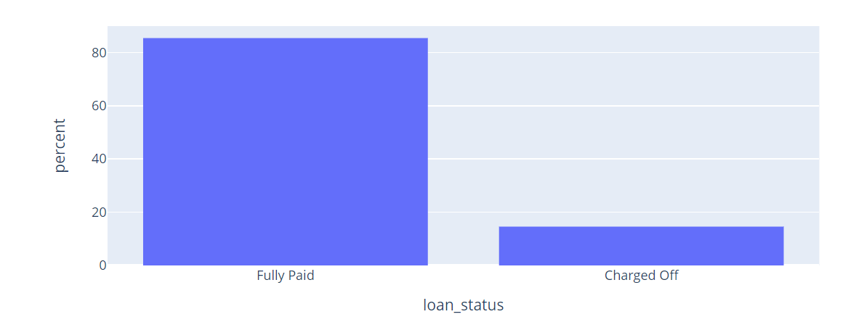
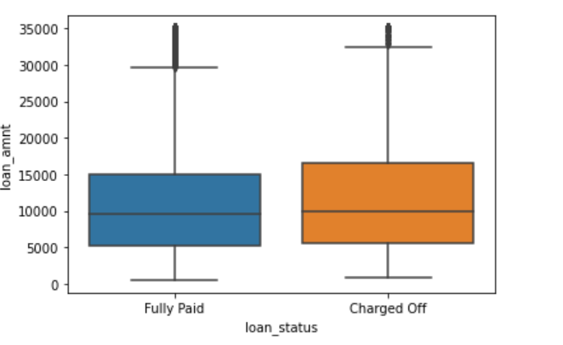
Loan Status and Amount
Loan Status:
* 83 % of the loans were fully paid
* 14 % were defaulted
* 3 % is current loan
Loan Amount: It varies from 5000 to 30000 with a median of 10000. Loan amount is majorly small and very few clients have taken large loans and larger it goes we have higher chance of defaulting.

Slide 10
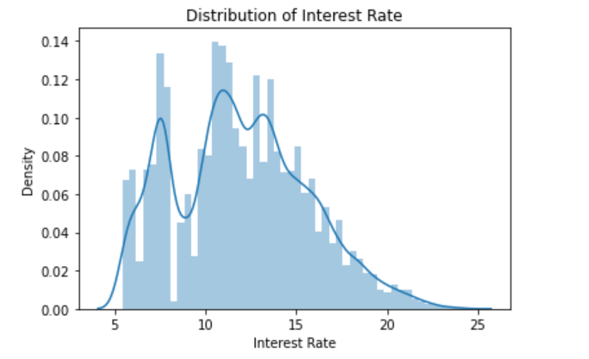
Term and Interest Rate
Interest Rate: The chance of defaulting increases with interest rate.

Slide 11
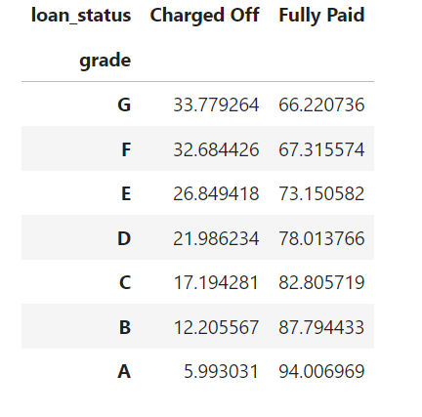
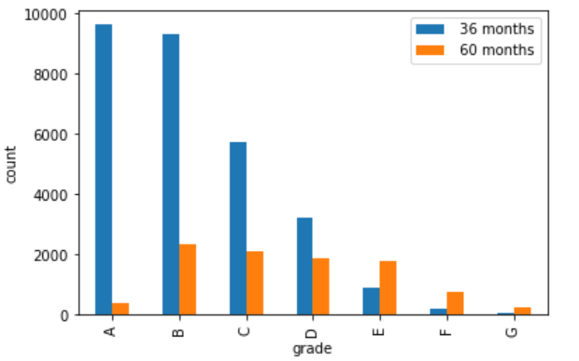
Distribution terms for Grades (Business Driven Matrix)
Grade: Higher(A) the grade greater the chance of paying loan.

Slide 12
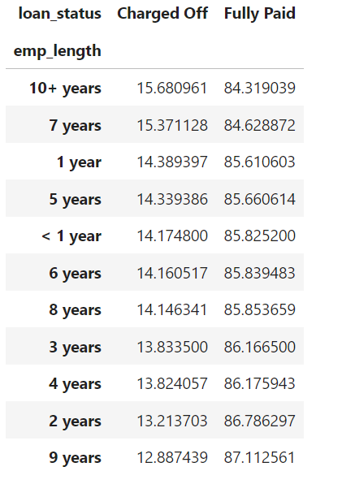
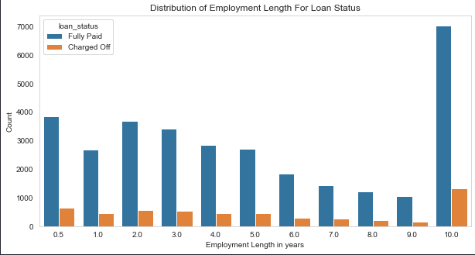
Employment Length
Employment Length: Majority of clients have 10+ years of experience and has highest proportion of defaulted loan.

Slide 13
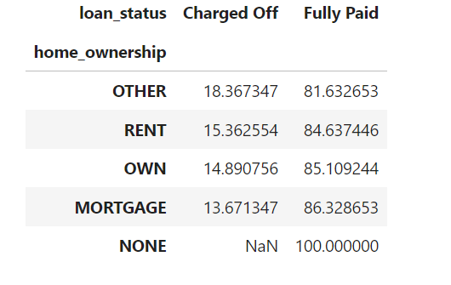
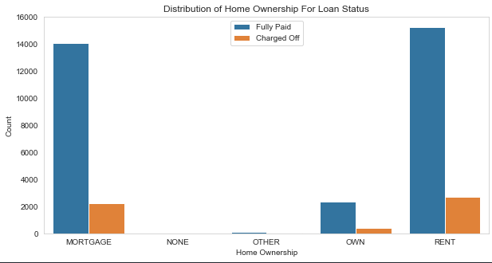
Home Ownership
Home ownership : people who has home ownership status as “Mortgage” or “Owner” has high chances of paying loan

Slide 14
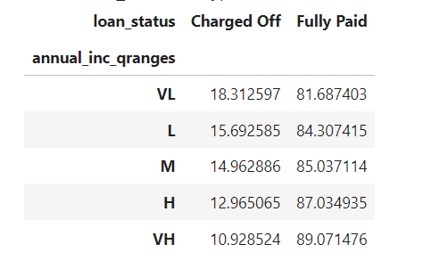
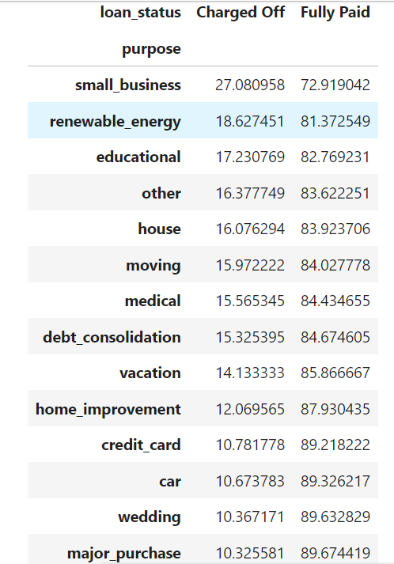
Annual Income & Purpose
Annual Income :
Very low (VL) Income group has maximum default
Purpose: Bank should be vigilant in providing loan to small business and renewable energy as they have maximum charge-off

Slide 15
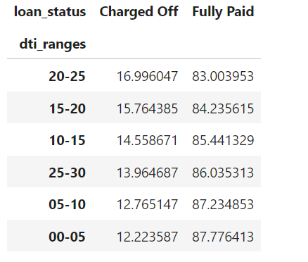
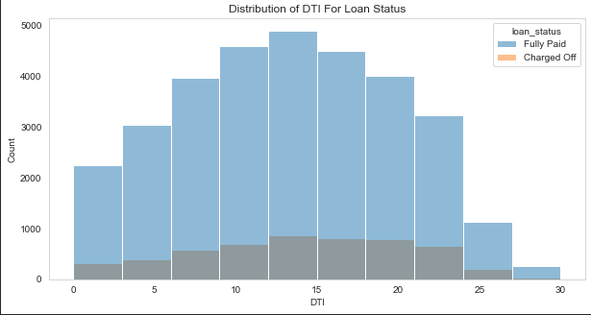
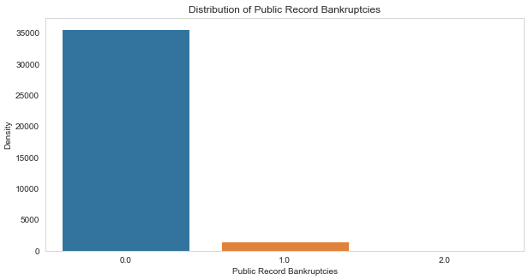
DTI ratio & Bankruptcy
DTI: The large percentage of Clients have a large Debt to Income ratio which shows that lending to such clients can be very risky.
Public Recorded Bankruptcy: Majority of clients have no record of declaring bankruptcy.

Slide 16
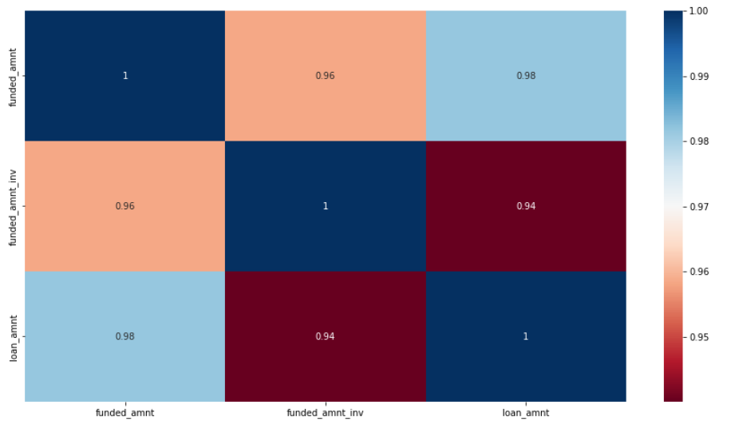
HeatMap
There is a high correlation between loan_amnt and funded_amnt, so one of them can be skipped

Slide 17
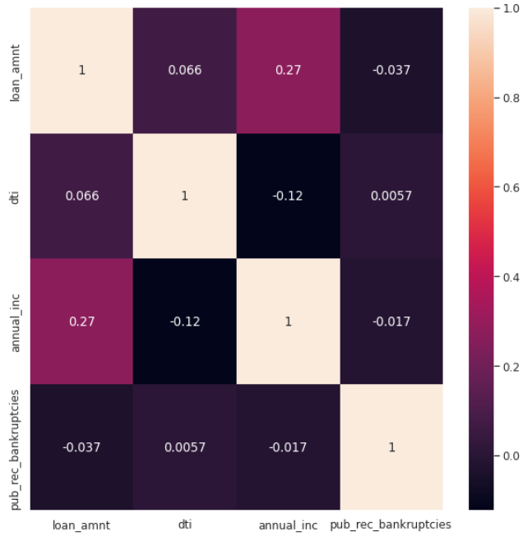
Correlation & Relationships
Negative Correlation
loan_amnt has negative correlation with pub_rec_bankrupticies
annual income has a negative correlation with dti
Strong Correlation
annual income has a strong correlation with loan_amount

Slide 18
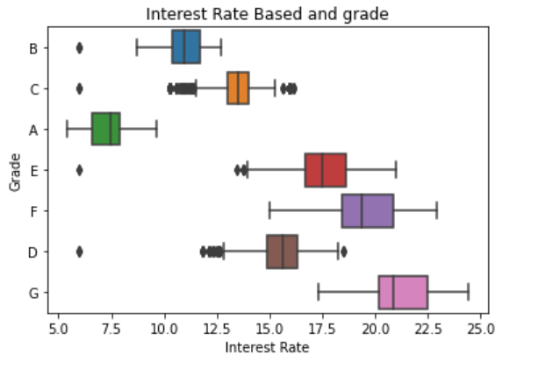
Bivariate Analysis
The Grade represent risk factor thus we can say interest rate increases with the risk.

Slide 19
Insights
Major Driving factor which can be used to predict the chance of defaulting and avoiding Credit Loss:
1. DTI
2. Grades/Sub-Grades
3. Verification Status
4. Annual income
5. Pub_rec_bankruptcies
Other considerations for 'defaults' :
1. Burrowers not from large urban cities e.g. NewYork , California etc
2. Burrowers having annual income in the range 50000-100000.
3. Burrowers having Public Recorded Bankruptcy.
4. Burrowers with least grades E.g. E,F,G indicates high risk.
5. Burrowers with very high Debt to Income value.
6. Burrowers with working experience 10+ years.

Slide 20
Conclusion
The default is highest for Other category and lowest for Mortgage category
Mortgage, Own, Rent are the best in repaying the loan and in that order
10+ years employees are defaulting about a percent more than the rest of the categories.
7 year employees also shows the similar trend
Verified category, source verified category is defaulting more when compared to not verified
Small business defaulters are way higher than the rest
DTI is able to find the defaulters in the right order. Higher the dti, higher the chance of default
The observation is same when the split/binning was done based on the ranges ['00-05', '05-10', '10-15', '15-20', '20-25', '25-30'] and based on the quantiles [0, 0.2, 0.4, 0.6, 0.8, 1]
Grade is also a strong indicator. Its shows similar trends as that of subgrades, subgrade F5 is 47% default

